Slide 1
B.Tech – CSE – Sem. 3 18CSS201J – ANALOG AND DIGITAL ELECTRONICS (Regulations 2018)
UNIT 4
Session-6(Edge Triggered J-K Fip-flop, Edge Triggered Master Slave Fip-flop)

Slide 2
J-K FLIP-FLOP
A J-K flip-flop has very similar characteristics to an S-R flip-flop. The only difference is that the undefined
condition for an S-R flip-flop, i.e., Sn = Rn = 1 condition, is also included in this case. Inputs J and K behave
like inputs S and R to set and reset the flip-flop respectively. When J = K = 1, the flip-flop is said to be in a
toggle state, which means the output switches to its complementary state every time a clock passes.
The data inputs are J and K, which are ANDed with Q' and Q respectively to obtain the inputs for S and R

Slide 3
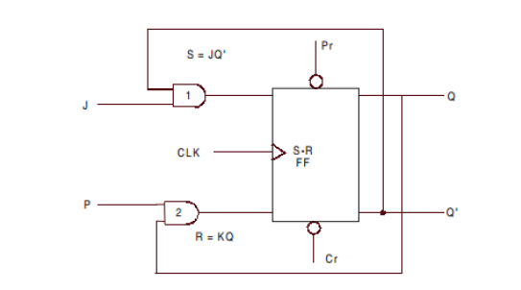
An S-R flip-flop converted into a J-K flip-flop

Slide 4
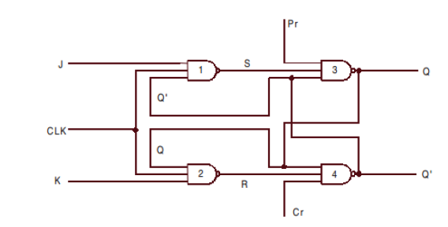
A J-K flip-flop using NAND gates

Slide 5
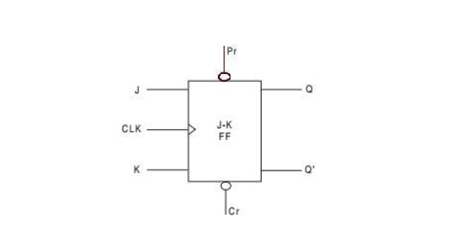
Logic symbol of a J-K flip-flop

Slide 6
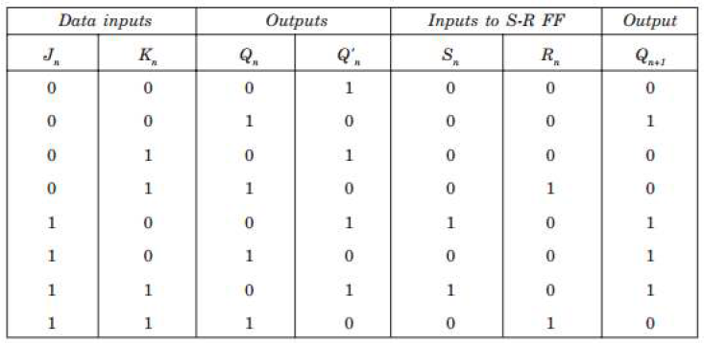
The TRUTH table for JK flip-flop

Slide 7
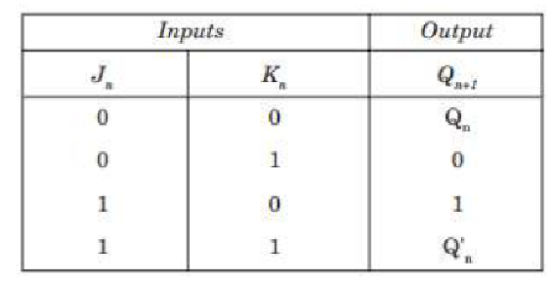
Case 1. When the clock is applied and J = 0, whatever the value of Q'n (0 or 1), the output of NAND gate 1 is 1.
Similarly, when K = 0, whatever the value of Qn (0 or 1), the output of gate 2 is also 1. Therefore, when J = 0 and K = 0, the inputs to the basic flip-flop are S = 1 and R = 1. This condition forces the flip-flop to remain in the same state.
Case 2. When the clock is applied and J = 0 and K = 1 & the previous state of the flip-flop is reset (i.e., Qn = 0 and Q'n = 1), then S = 1 and R = 1. Since S = 1 and R = 1, the basic flip-flop does not alter the state and remains in the reset state. But if the flip-flop is in set condition (i.e., Qn = 1 & Q'n = 0), then S = 1 and R = 0. Since S = 1 and R = 0, the basic flip-flop changes its state and resets.

Slide 8
Case 3. When the clock is applied and J = 1 and K = 0 and the previous state of the flip-flop is reset (i.e., Qn = 0 and Q'n = 1), then S = 0 and R = 1. Since S = 0 and R = 1, the basic flip-flop changes its state and goes to the set state. But if the flip-flop is already in set condition (i.e., Qn = 1 and Q'n = 0), then S = 1 and R = 1. Since S = 1 and R = 1, the basic flip-flop does not alter its state and remains in the set state.
Case 4. When the clock is applied and J = 1 and K = 1 and the previous state of the flip-flop is reset (i.e., Qn = 0 and Q'n = 1), then S = 0 and R = 1. Since S = 0 and R = 1, the basic flip-flop changes its state and goes to the set state. But if the flip-flop is already in set condition (i.e., Qn = 1 and Q'n = 0), then S = 1 and R = 0. Since S = 1 and R = 0, the basic flip-flop changes its state and goes to the reset state. So we find that for J = 1 and K = 1, the flip-flop toggles its state from set to reset and vice versa. Toggle means to switch to the opposite state.

Slide 9
Master-Slave Flip-Flops (Pulse Triggered Flip-Flops)
Aside from latches, two categories of flip-flops.
Master-slave flip-flops (pulse-triggered flip-flops)
Edge-triggered flip-flops
Latches have immediate output response (known as transparency)
May be undesirable:
May be necessary to sense the current state of a flip-flop while allowing new state information to be entered.

Slide 10
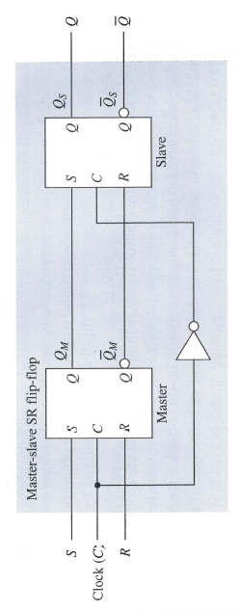
Master-Slave SR Flip-Flop
Two sections, each capable of storing a binary symbol.
First section is referred to as the master and the second section as the slave.
Information is entered into the master on one edge or level of a control signal and is transferred to the slave on the next edge or level of the control signal.
Each section is a latch.

Slide 11
Master-Slave SR Flip-Flop
C = 0:
Master is disabled. Any changes to S,R ignored.
Slave is enabled. Is in the same state as the master.
C = 1:
Slave is disabled (retains state of master)
Master is enabled, responds to inputs. Changes in state of master are not reflected in disabled slave.
C = 0:
Master is disabled.
Slave is enabled and takes on new state of the master.
Important: For short periods during rising and falling edges, both master and slave are disabled.

Slide 12
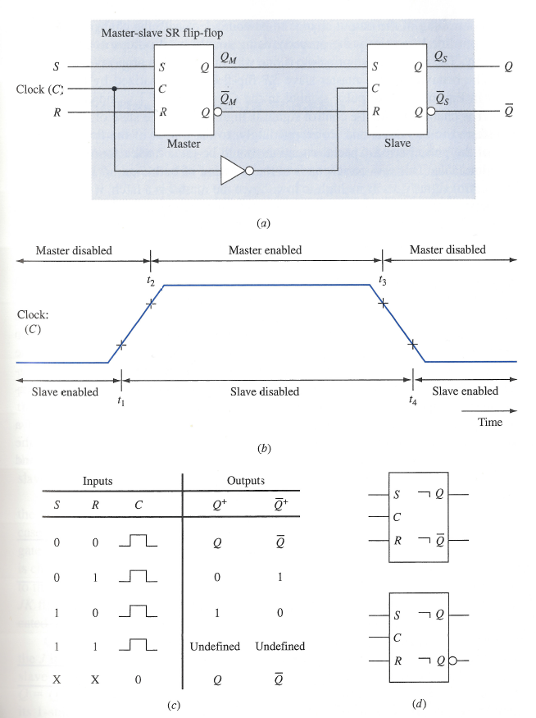
Master-Slave SR Flip-Flop
Pulse symbol indicates master enabled when C = 1 and state of master transferred to slave at the end of the pulse period.
Slave only takes on state of the master at $t_{4}.$
Postponed output indicator: output change postponed until end of pulse
If S, R = 1 when control signal goes from high to low we are in an unpredicable state. Can cause metastable state.

Slide 13
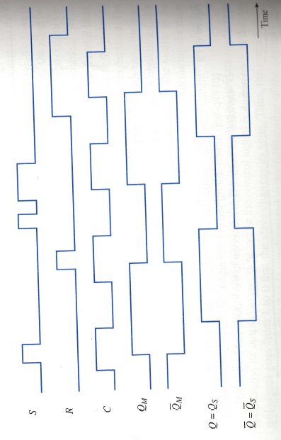
Timing Diagram for Master-Slave SR flip-flop

Slide 14
Master-Slave JK Flip-Flop
The output state of a master-slave SR flip-flop is undefined upon returning the control input to 0 when S = R = 1.
Necessary to avoid this condition.
Master-slave JK flip-flop allows its two information input lines to be simultaneously 1.
Results in toggling the output of the flip flop.

Slide 15
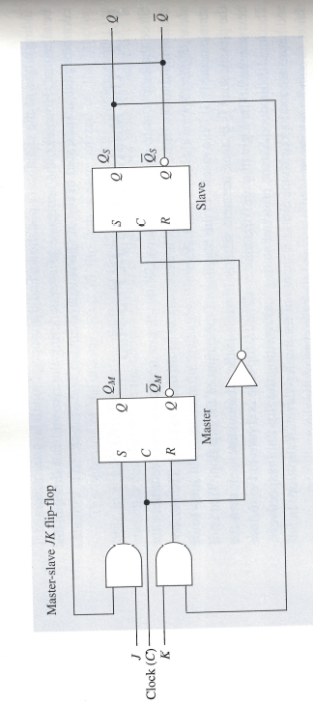
Master-Slave JK Flip-Flop
Assume in 1-state, C = 0, J = K = 1.
Due to feedback, the output of the J-gate is 0, output of K-gate is 1.
If clock is changed to C = 1 then master is reset.
Assume in 0-state, C = 0, J = K = 1.
Due to feedback, the output of the J-gate is 1, output of K-gate is 0.
If clock is changed to C = 1 then master is set.
1 on J input line, 0 on K input line sets the flip-flop.
If in 1-state, unchanged b/c S,R set to 0.
If in 0-state, S set to 1, R set to 0.
0 on J input, 1 on K input line resets the flip-flop. Why?

Slide 16
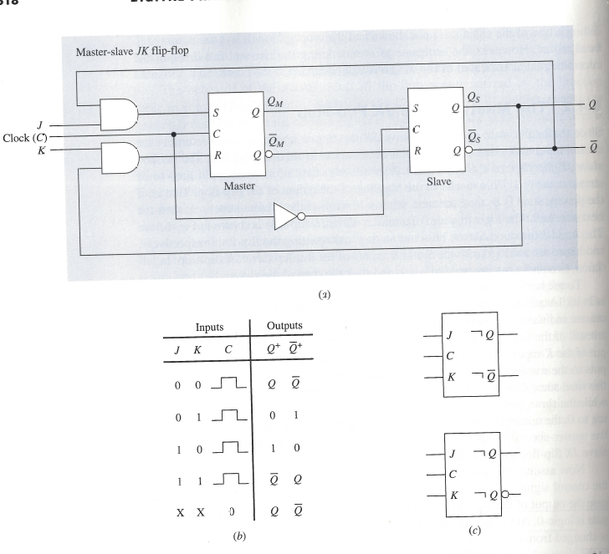
Master-Slave JK Flip-Flop

Slide 17
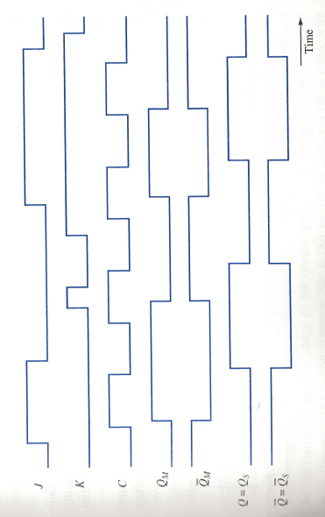
Timing Diagram for Master-Slave JK Flip-Flop

